Slide 1

Inception Separable CNN for Retinal Disease Classification
Name： Eve
Student Number: 202018010304
1

Slide 2
Outline of Presentation
1
Introduction
4
Results
2
5
Limitations and Challenges
Background Review
Conclusion
3
Methodology
6
2

Slide 3
1
INTRODUCTION
Aims
Objectives
3

Slide 4
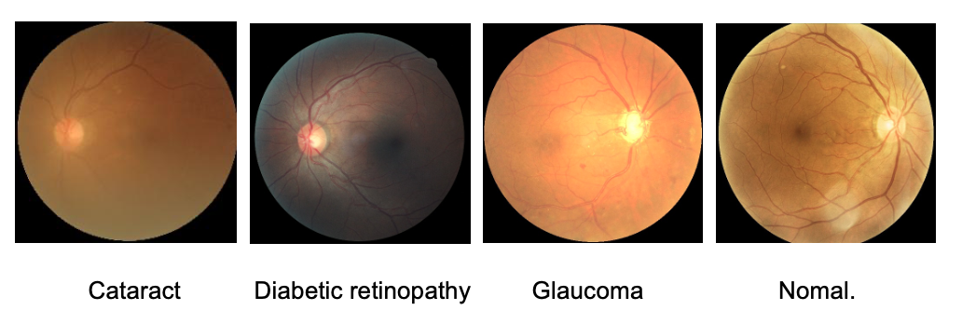
Introduction - Aims
1
Combine the Separable CNN with Inception model.
Increase the accuracy of model for precise diagnosis of retinal disease.
Design a web application for the model.
Figure 1 Samples of retinal disease OCT images
4

Slide 5
Introduction - Objectives
1
Search and compare existing retinal disease classification models.
Construct deep learning model based on separable CNN with Inception model.
Optimize the model to improve accuracy.
Compare the performance of different model with the proposed model using the same dataset.
Present the graphic user interface (GUI) to the direct audience.
5

Slide 6
2
Background Review
Comparison of existing models proposed in different papers
6

Slide 7
Existing models proposed in different papers
Researchers | Year | Techniques | Accuracy
Meenu et al. [1] | 2022 | Depthwise separable CNN | 93.5%
Kermany et al. [2] | 2018 | Inception V3 | 96.6%
Alqudah et al. [3] | 2019 | Novel Automatic CNN structure | 95.3%
Rajagopalan et al. [4] | 2021 | Deep CNN framework | 95.7%
Mahendran et al. [5] | 2020 | Decision tree classifier | 92%
Najeeb et al. [6] | 2018 | Single layer CNN structure. | 95.66%
Bhadra and Kar [7] | 2020 | Deep multi-layered CNN | 96.5%
Intaraprasit et al. [8] | 2023 | MobileNetV2 | 99.8%
Table 1 Literature Review of different approach about retinal disease classification
7

Slide 8
3
Methodologies
The proposed architecture of the project
8

Slide 9
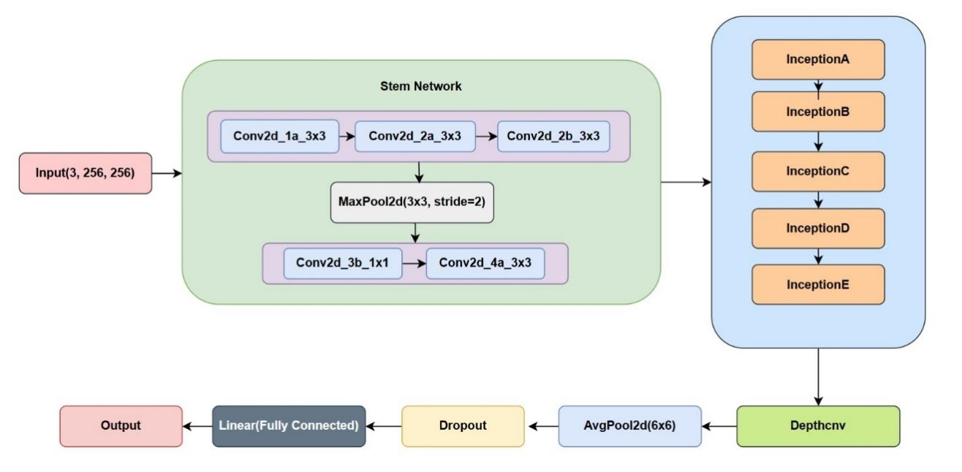
Methodologies - Model Architecture
3
Figure 2 Model architecture
9

Slide 10
4
Results
Model Performance
Model Explainability
GUI Design
10

Slide 11
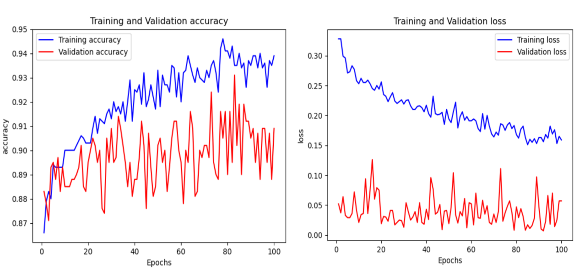
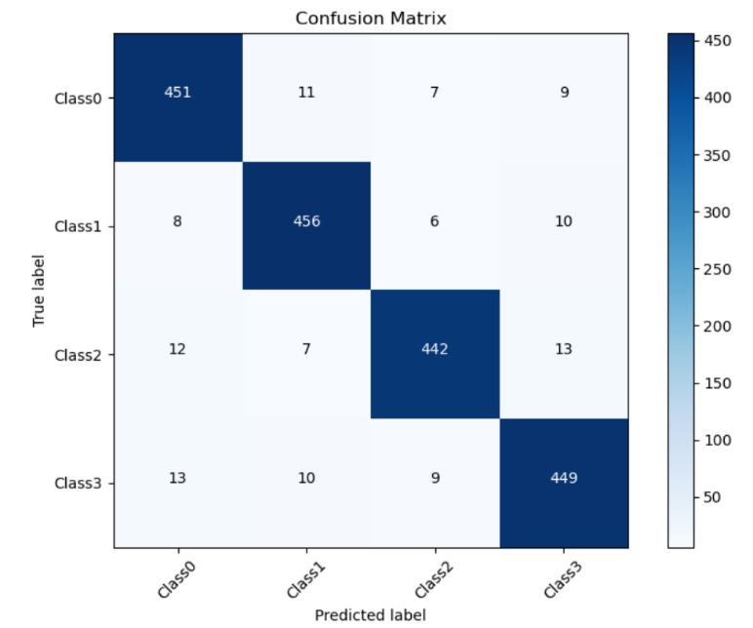
4
Results
- Model Performance
Hyper-parameter | value
Batch size | 70
Learning rate | 0.0001
Epoch | 100
Table 2 Hyper-parameters setting
Evaluation metric | Result
Validation loss | 0.057
Validation accuracy | 91.9%
Precision (macro) | 0.909
Recall (macro) | 0.909
F1-Score | 0.908
Figure 3 Model accuracy and loss curve
Validation loss = 0.057
Validation accuracy = 91.9%
Train loss = 0.159
Train accuracy = 94.6%
Table 3 Model performance
11
Figure 4 Confusion matrix

Slide 12
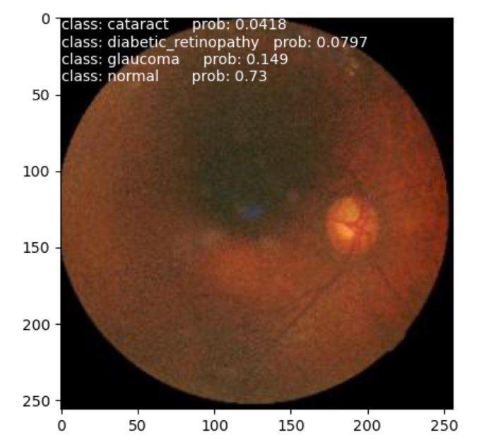
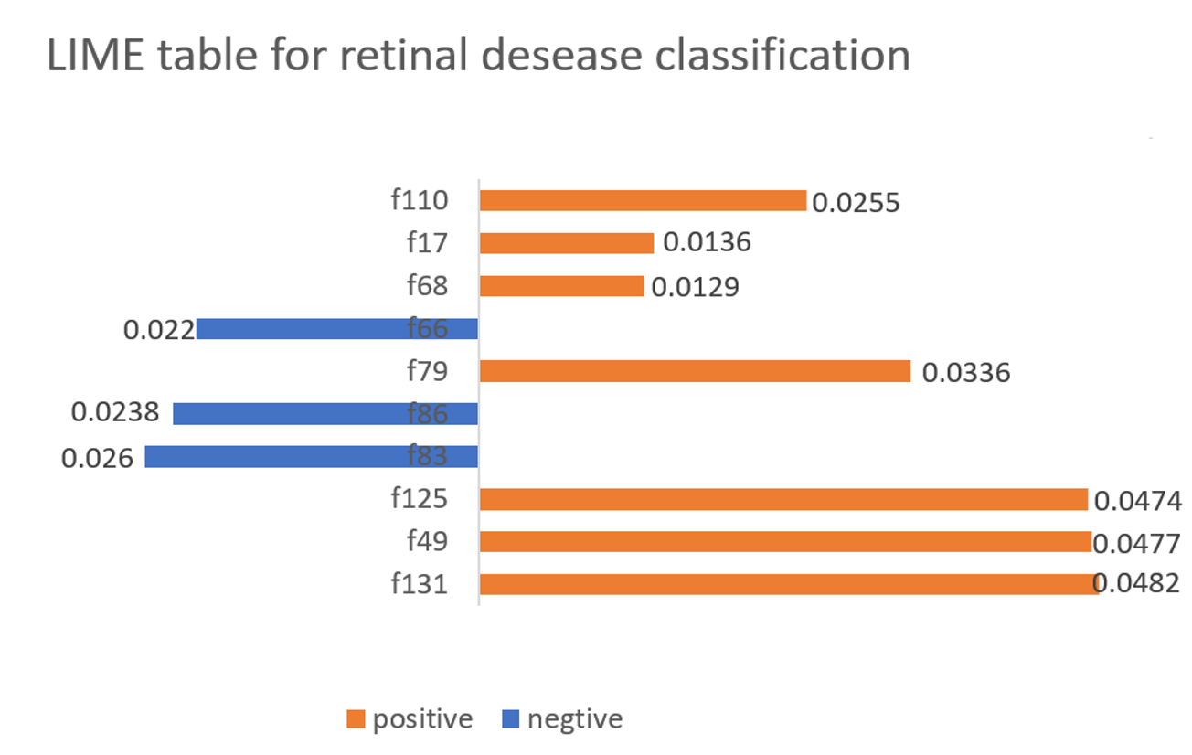
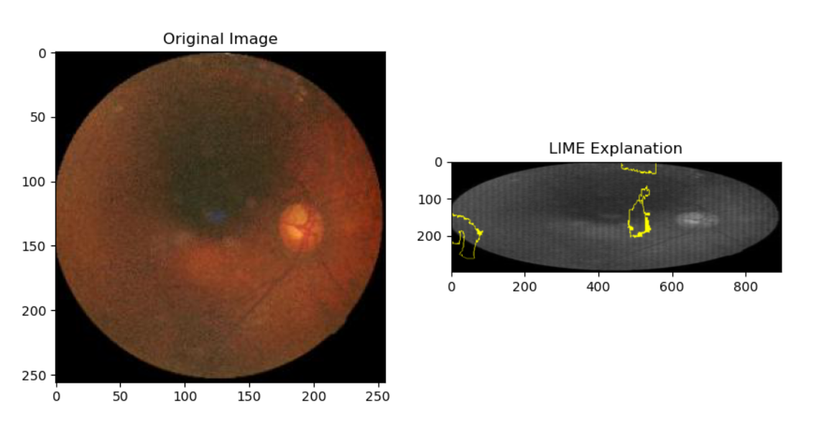
4
Results
- Model Explainability
Figure 5 Model prediction
Figure 7 LIME explanation table
12
Figure 6 LIME explanation

Slide 13
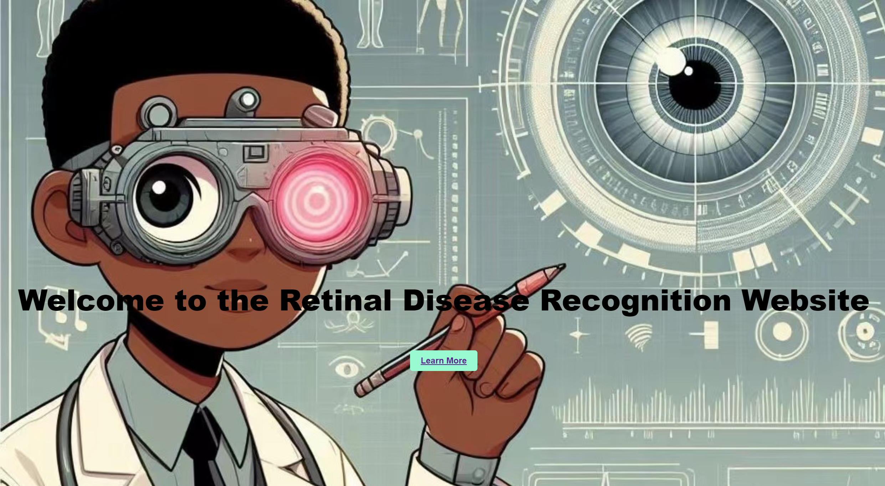
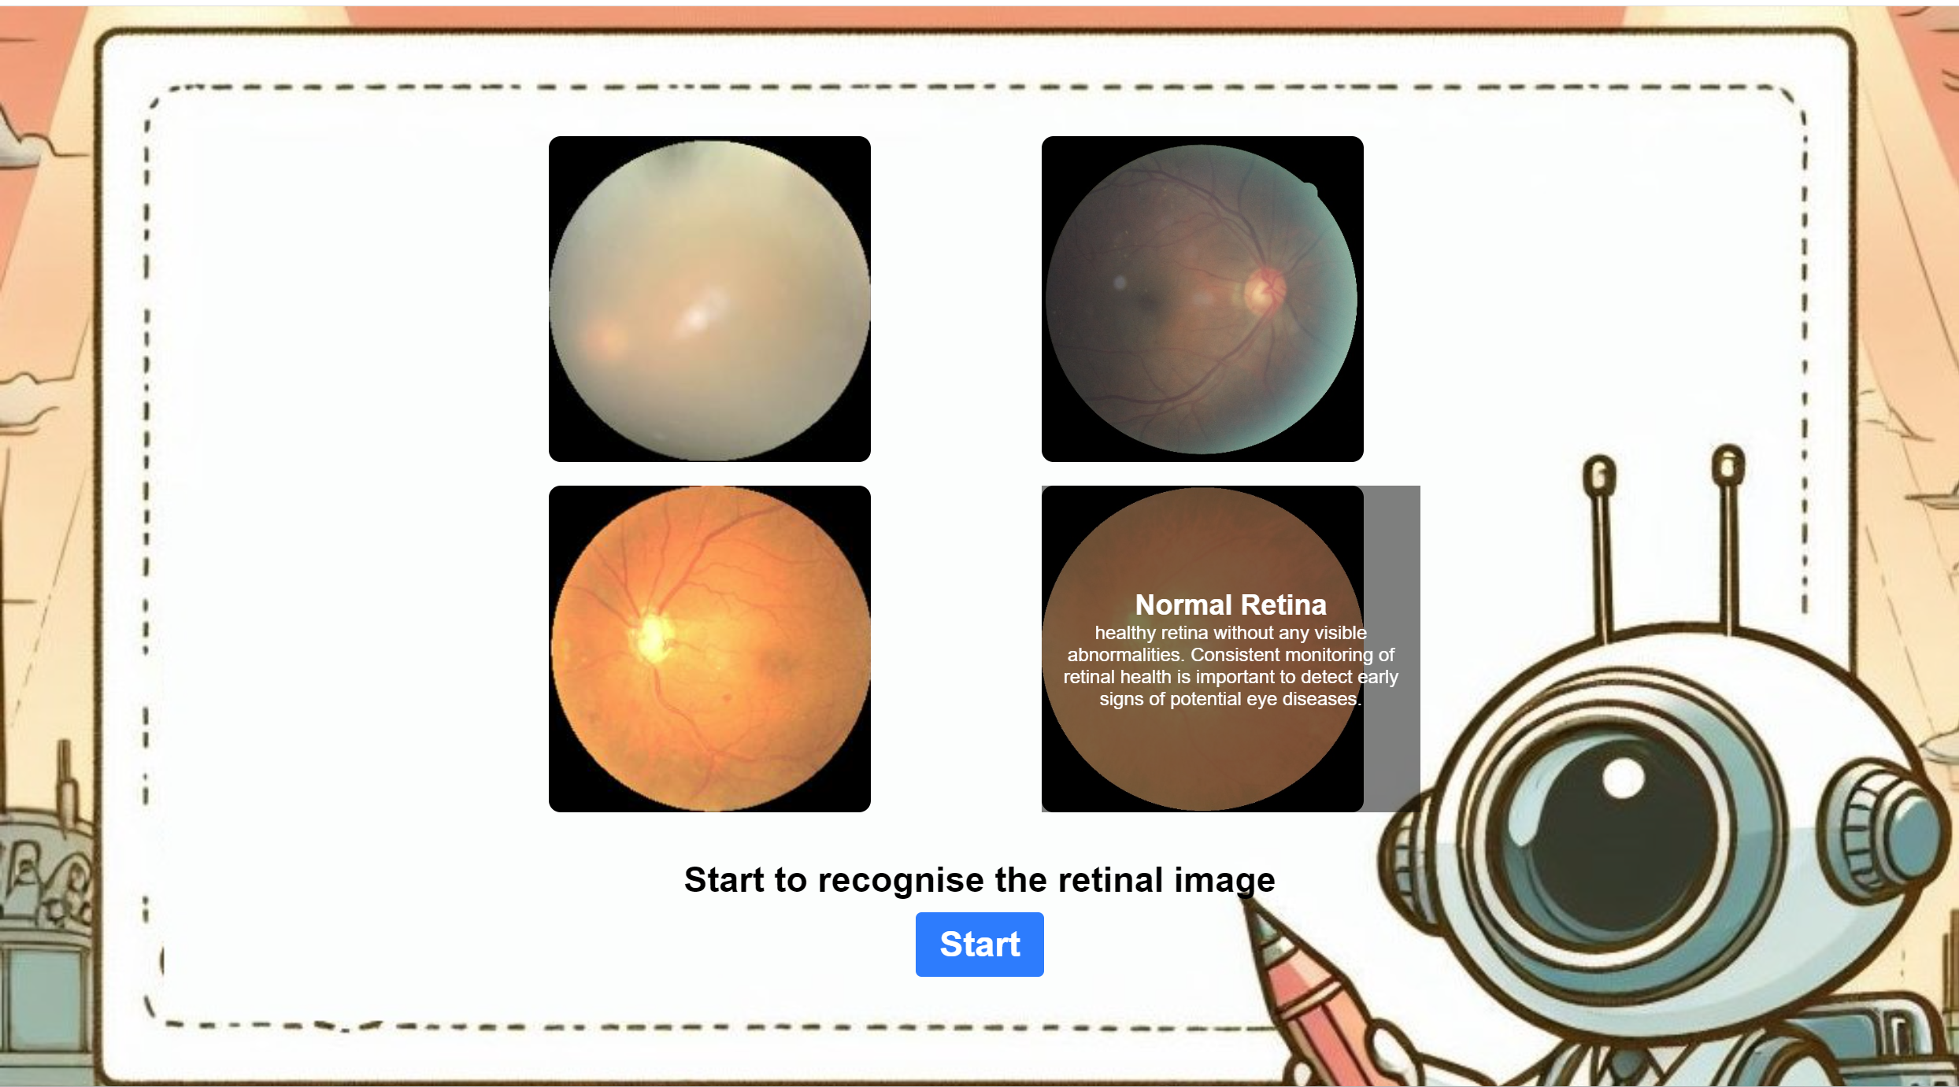
4
Results
- GUI Design
Figure 8 Home page of web app
Figure 9 Learn more page of web app
13

Slide 14
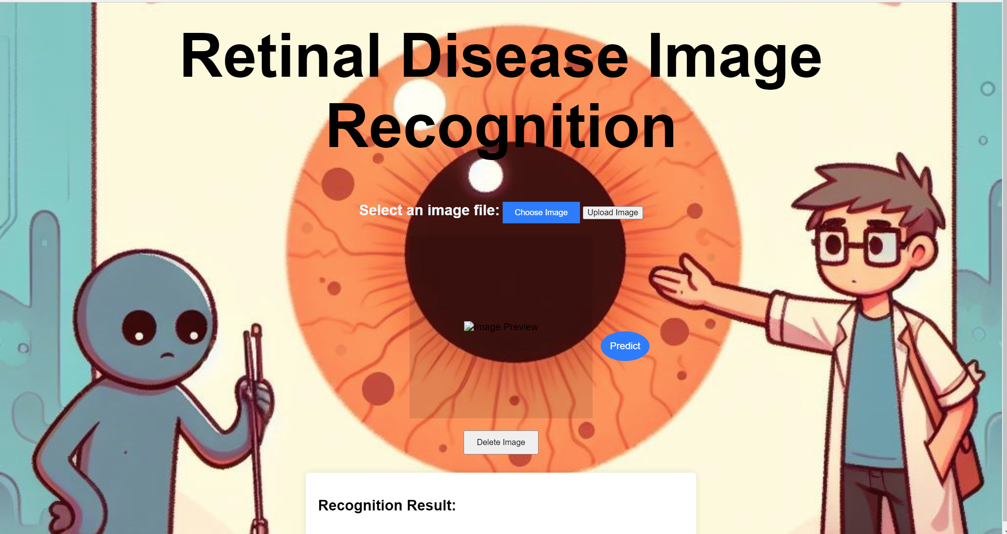
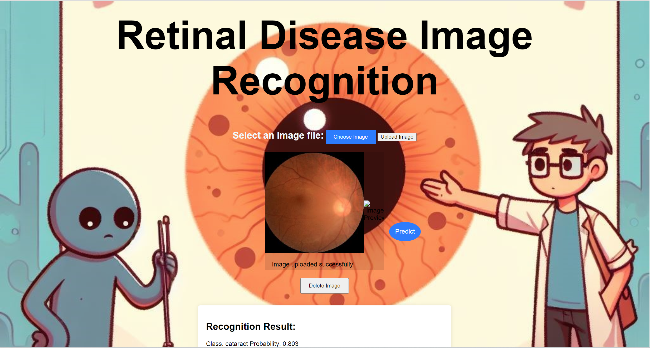
4
Results
- GUI Design
Figure 10 Prediction page of web app
14
Figure 11 Demonstration of web app

Slide 15
5
Limitations and Challenges
15

Slide 16
5
Limitations and Challenges
Limited dataset: Insufficient image diversity.
Enhancing model precision required.
Inadequate data protection measures: Insufficient safeguarding of data.
16

Slide 17
6
Conclusion
17

Slide 18
6
Conclusion
Model architecture: Combined Inception and separable CNN.
Automation of disease identification: Reduces manual reliance.
Model evaluation: Training accuracy 94.6%, validation accuracy 91.9%, validation loss 0.057.
Superiority over other models: High accuracy compared to ResNet, MobileNetV2.
18

Slide 19
6
Conclusion
- Future Work
Dataset improvement: Increase diversity, representativeness.
Technique enhancement: Integrate new ML techniques.
Parameter optimization: Further adjust for accuracy.
Healthcare system integration: Combine real-time data.
19

Slide 20
Thanks for listening
20

Slide 21
Reference
[1] S. Meenu Mohan and S. Aji, "A Fast Method for Retinal Disease Classification from OCT Images Using Depthwise Separable Convolution," in R. Raje, F. Hussain, and R. J. Kannan (eds.), Artificial Intelligence and Technologies, Lecture Notes in Electrical Engineering, vol. 806, Springer, Singapore, 2022, pp. 223-232, doi: 10.1007/978-981-16-6448-9_18.
[2] D. S. Kermany et al., "Identifying medical diagnosis and treatable diseases by image based deep learning," in Cell, vol. 172, no. 5, pp. 1122-1131, 2018.
[3] A. Alqudah, "A OCT-NET a convolutional network automated classification of multiclass retinal disease classification using SD-OCT images," in International federation for medical and biological engineering, 2019.
[4] N. Rajagopalan, V. Narasimhan, S. Kunnavakkam Vinjimoor et al., "RETRACTED ARTICLE: Deep CNN framework for retinal disease diagnosis using optical coherence tomography images," in J Ambient Intell Human Comput, vol. 12, pp. 7569-7580, 2021, doi: 10.1007/s12652-020-02460-7.
[5] G. Mahendran, M. Periyasamy, S. Murugeswari, and N. K. Devi, "Analysis on retinal diseases using machine learning algorithms," in Mater. Today, Proc., vol. 33, pp. 3102-3107, Jan. 2020.
{6] S. Najeeb, N. Sharmile, M. S. Khan, I. Sahin, M. T. Islam and M. I. Hassan Bhuiyan, "Classification of Retinal Diseases from OCT scans using Convolutional Neural Networks," 2018 10th International Conference on Electrical and Computer Engineering (ICECE), Dhaka, Bangladesh, 2018, pp. 465-468, doi: 10.1109/ICECE.2018.8636699.
[7] R. Bhadra and S. Kar, "Retinal Disease Classification from Optical Coherence Tomographical Scans using Multilayered Convolution Neural Network," 2020 IEEE Applied Signal Processing Conference (ASPCON), Kolkata, India, 2020, pp. 212-216, doi: 10.1109/ASPCON49795.2020.9276708.
[8] P. Intaraprasit, T. H. Bui and M. Phu Paing, "MobileNetV2-based Deep Learning for Retinal Disease Classification on a Mobile Application," 2023 15th Biomedical Engineering International Conference (BMEiCON), Tokyo, Japan, 2023, pp. 1-5, doi: 10.1109/BMEiCON60347.2023.10322079.
21

